Slide 1
Week 7c
COMPUTATIONAL MATHEMATICS
Interpolation – Lagrange Interpolation

Slide 2
Reference
Kisualaas, Jann. (2013). Numerical Methods in Engineering with Python 3. Cambridge University Press.
Johansson, Robert. (2015). Chapter 5. Equation Solving. Numerical Python: A Practical Techniques Approach for Industry, Apress.
Chapra, S. C., and Raymond P. Canale. (2010). Numerical methods for engineers, Sixth edition, McGraw Hill.
Kaw, A. (n.d.). Numerical Methods. Retrieved March 20, 2020, from https://nm.mathforcollege.com/

Slide 3
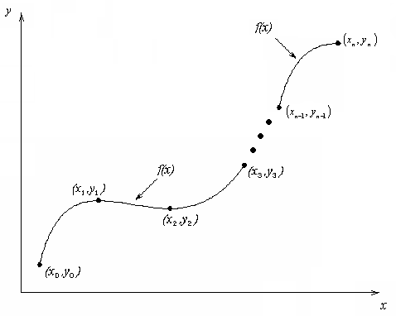
What is Interpolation ?
Given (x₀,y₀), (x₁,y₁), …… (x_{n},y_{n}), find the value of ‘y’ at a value of ‘x’ that is not given.

Slide 4
Interpolants
Polynomials are the most common choice of interpolants because they are easy to:
Evaluate
Differentiate, and
Integrate.

Slide 5
Lagrangian Interpolation

Slide 6
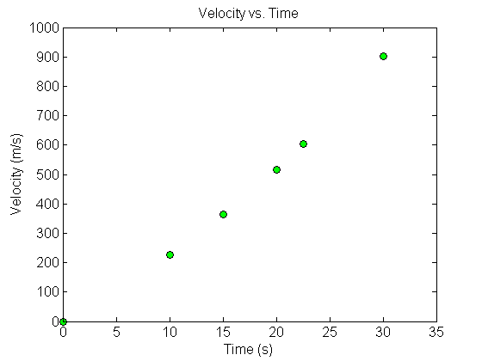
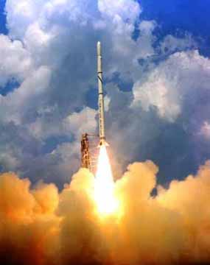
Example
The upward velocity of a rocket is given as a function of time in Table 1. Find the velocity at t=16 seconds using the Lagrangian method for linear interpolation.
Table Velocity as a
function of time
(s) | (m/s)
0 | 0
10 | 227.04
15 | 362.78
20 | 517.35
22.5 | 602.97
30 | 901.67
Figure. Velocity vs. time data
for the rocket example

Slide 7
Linear Interpolation

Slide 8
Linear Interpolation (contd)

Slide 9
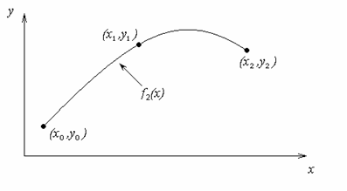
Quadratic Interpolation

Slide 10
Example
The upward velocity of a rocket is given as a function of time in Table 1. Find the velocity at t=16 seconds using the Lagrangian method for quadratic interpolation.
Table Velocity as a
function of time
(s) | (m/s)
0 | 0
10 | 227.04
15 | 362.78
20 | 517.35
22.5 | 602.97
30 | 901.67
Figure. Velocity vs. time data
for the rocket example

Slide 11
Quadratic Interpolation (contd)

Slide 12
Quadratic Interpolation (contd)
The absolute relative approximate error obtained between the results from the first and second order polynomial is

Slide 13
Cubic Interpolation

Slide 14
Example
The upward velocity of a rocket is given as a function of time in Table 1. Find the velocity at t=16 seconds using the Lagrangian method for cubic interpolation.
Table Velocity as a
function of time
(s) | (m/s)
0 | 0
10 | 227.04
15 | 362.78
20 | 517.35
22.5 | 602.97
30 | 901.67
Figure. Velocity vs. time data
for the rocket example

Slide 15
Cubic Interpolation (contd)

Slide 16
Cubic Interpolation (contd)
The absolute relative approximate error obtained between the results from the first and second order polynomial is

Slide 17
Comparison Table
Order of Polynomial | 1 | 2 | 3
v(t=16) m/s | 393.69 | 392.19 | 392.06
Absolute Relative Approximate Error | -------- | 0.38410% | 0.033269%

Slide 18
Distance from Velocity Profile
Find the distance covered by the rocket from t=11s to
t=16s ?

Slide 19
Acceleration from Velocity Profile
Find the acceleration of the rocket at t=16s given that
,

